Slide 1
Unit 3: Syntax Parsing

Slide 2
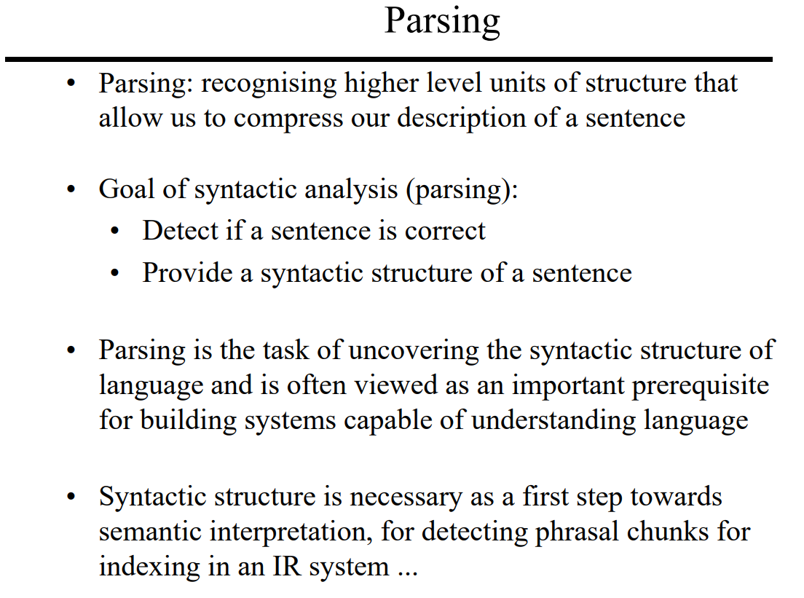

Slide 3
In syntactic analysis, we target the roles played by words in a sentence, interpreting the relationship between words and the grammatical structure of sentences.
For example, let’s take these two sentences :
Delhi is the capital of India.
Is Delhi the of India capital.
Both sentences have the same words, but only the first one is syntactically correct and understandable.
Basic lexical processing techniques cannot make this distinction.
Therefore, more sophisticated syntax processing techniques are needed to understand the relationship between individual words in a sentence.

Slide 4
Syntactical analysis looks at the following aspects in the sentence which lexical doesn’t :
Words order and meaning: Syntactical analysis aims to find how words are dependent on each other. Changing word order will make it difficult to comprehend the sentence.
Retaining stop-words: Removing stop-words can altogether change the meaning of a sentence.
Morphology of words: Stemming, lemmatization will bring the words to its base form, thus modifying the grammar of the sentence.
Parts-of-speech of words in a sentence: Identifying correct part-of-speech of a word is important. Example — ‘cuts and bruises on his face’ (Here ‘cuts’ is a noun) & ‘he cuts an apple’ (Here, ‘cuts’ is a verb).

Slide 5
Conclusion
One of the most important parts of syntactic processing is parsing.
It means to break down a given sentence into its ‘grammatical constituents’.
Let’s understand through an example.
Suppose you ask a question to a question-answering (QA) system, such as Siri or Alexa, the following question: “Who won the Formula 1 championship in 2019?”
The QA system can meaningfully respond only if it can understand that the phrase ‘Formula 1 championship’ relates to the phrase ‘in 2019’.
The phrase ‘in 2019’ refers to a specific time frame, and thus significantly revises the question.
Finding such dependencies or relationships between the phrases of a sentence can be achieved through parsing techniques.

Slide 6
Parsing
Let’s take another sentence to understand how a parsed sentence looks like: “The quick brown fox jumps over the table”. The sentence is divided into three main constituents:
‘The quick brown fox’ is a noun phrase
‘jumps’ is a verb phrase
‘over the table’ is a prepositional phrase.
Now, let us understand the different levels of syntactic analysis that we apply to any given text.

Slide 7
So how to deal with this ambiguity
To deal with the complexity and ambiguity of natural language, we first need to identify and define commonly seen grammatical patterns.
The first step in understanding grammar is to divide words into groups, called constituents, based on their grammatical role in the sentence.
Let’s take an example to understand constituents in detail. Consider a sentence ‘Ishan — read — an article on Syntactic Analysis’.
The group of words separated by the hyphen form a constituent (or a phrase).
The justification for placing these words in a unit is provided by the notion of substitution, that is, a component can be replaced with another equivalent component, keeping the sentence syntactically valid.

Slide 8
So how to deal with this ambiguity
For example, replacing the constituency ‘an article on Syntactic Analysis’ (a noun phrase) with ‘lunch’ (another noun phrase) doesn’t affect the syntax of the sentence, though the resultant sentence “Ishan read lunch” is semantically meaningless.
The most common constituencies in English are Noun Phrases (NP), Verb Phrases (VP), and Prepositional Phrases (PP).
There are various other types of phrases, such as an adverbial phrase, a nominal (N), etc., though in most cases we work with only the above three phrases along with the nominal.

Slide 9
Part-of-speech (POS) tagging
Let’s start with the first level of syntactic analysis-POS (speech of parts) tagging.
A word can be tagged as a noun, verb, adjective, adverb, preposition, etc. depending on its role in the sentence.
Assigning correct tags such as nouns, verbs, adjectives, etc. is one of the most fundamental functions in syntactic analysis.
For example, you ask Alexa or google home a question — “Ok Google, where can I get a permit to travel between different states?”.
Now, the word ‘permit’ may possibly have two POS tags — a noun and a verb. In the phrase ‘I need a work permit’, the correct tag of ‘permit’ is ‘noun’.
On the other hand, in the phrase “Please permit me to go outside.”, The word ‘permit’ is a ‘verb’.

Slide 10
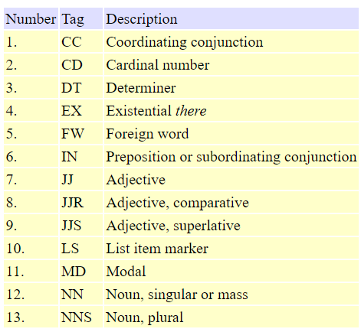
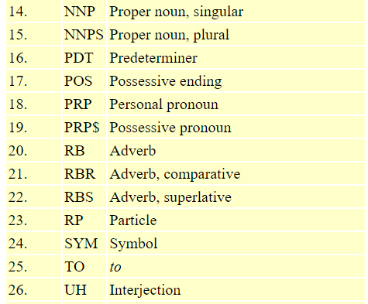
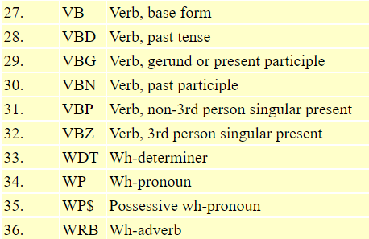
Part-of-speech (POS) tagging
Assigning the correct POS tag helps us to better understand the intended meaning of a phrase or sentence and is thus an important part of syntactic processing.
In fact, all subsequent parsing techniques (constituency parsing, dependency parsing, etc.) use part-of-speech tags to parse a sentence.
There are 36 types of POS tags are defined in Penn Treebank P.O.S. Tags.

Slide 11
Types of Part-of-speech (POS) tagging
Tagging is a kind of classification that may be defined as the automatic assignment of description to the tokens.
In simple words, we can say that POS tagging is a task of labelling each word in a sentence with its appropriate part of speech.
We already know that parts of speech include nouns, verb, adverbs, adjectives, pronouns, conjunction and their sub-categories.
Most of the POS tagging falls under Rule Based POS tagging, Stochastic POS tagging and Transformation based tagging.

Slide 12
Rule-based POS Tagging
One of the oldest techniques of tagging is rule-based POS tagging.
Rule-based taggers use dictionary or lexicon for getting possible tags for tagging each word. If the word has more than one possible tag, then rule-based taggers use hand-written rules to identify the correct tag.
Disambiguation can also be performed in rule-based tagging by analyzing the linguistic features of a word along with its preceding as well as following words.
For example, suppose if the preceding word of a word is article then word must be a noun.
Context-pattern rules
Or, as Regular expression compiled into finite-state automata, intersected with lexically
ambiguous sentence representation.

Slide 13
Stochastic POS Tagging
Another technique of tagging is Stochastic POS Tagging. Now, the question that arises here is which model can be stochastic.
The model that includes frequency or probability (statistics) can be called stochastic. Any number of different approaches to the problem of part-of-speech tagging can be referred to as stochastic tagger.
The simplest stochastic tagger applies the following approaches for POS tagging −
Word Frequency Approach
In this approach, the stochastic taggers disambiguate the words based on the probability that a word occurs with a particular tag. We can also say that the tag encountered most frequently with the word in the training set is the one assigned to an ambiguous instance of that word. The main issue with this approach is that it may yield inadmissible sequence of tags.

Slide 14
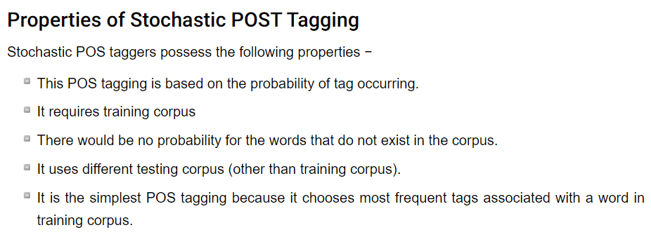
Stochastic POS Tagging
Tag Sequence Probabilities
It is another approach of stochastic tagging, where the tagger calculates the probability of a given sequence of tags occurring. It is also called n-gram approach. It is called so because the best tag for a given word is determined by the probability at which it occurs with the n previous tags.

Slide 15
Transformation-based Tagging
Transformation based tagging is also called Brill tagging. It is an instance of the transformation-based learning (TBL), which is a rule-based algorithm for automatic tagging of POS to the given text.
TBL, allows us to have linguistic knowledge in a readable form, transforms one state to another state by using transformation rules.
It draws the inspiration from both the previous explained taggers − rule-based and stochastic. If we see similarity between rule-based and transformation tagger, then like rule-based, it is also based on the rules that specify what tags need to be assigned to what words.
On the other hand, if we see similarity between stochastic and transformation tagger then like stochastic, it is machine learning technique in which rules are automatically induced from data.

Slide 16
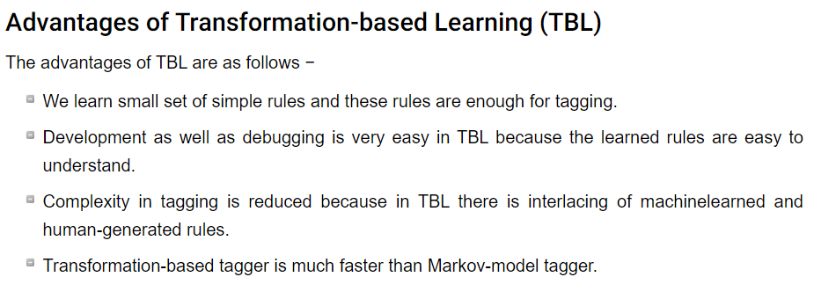
Transformation-based Tagging

Slide 17
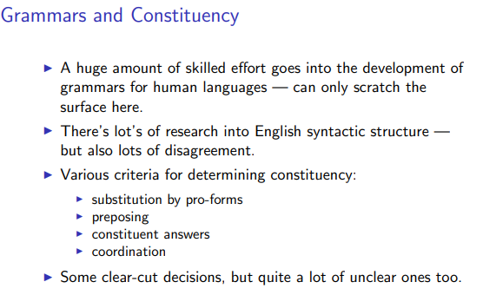
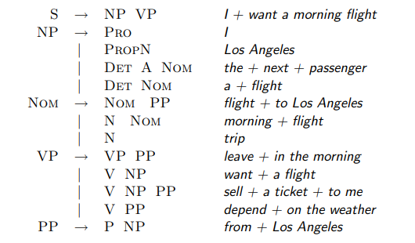
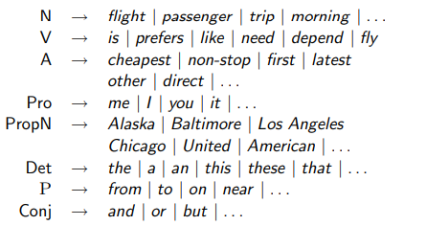
Grammars and Constituency

Slide 18
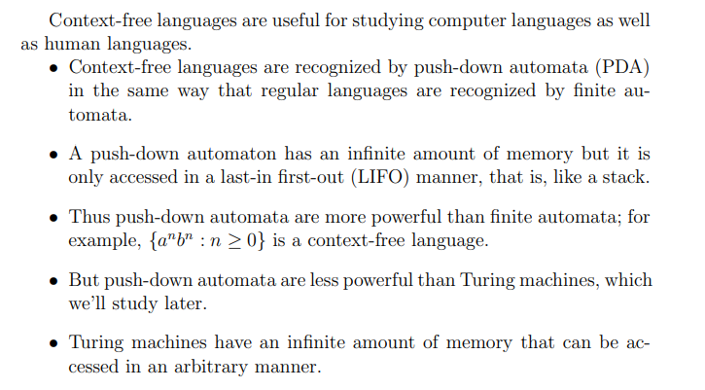
Context-Free Grammars for English

Slide 19
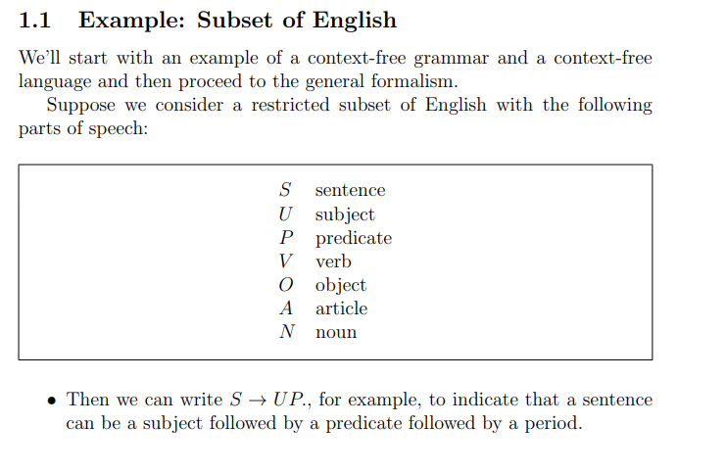
Context-Free Grammars for English

Slide 20
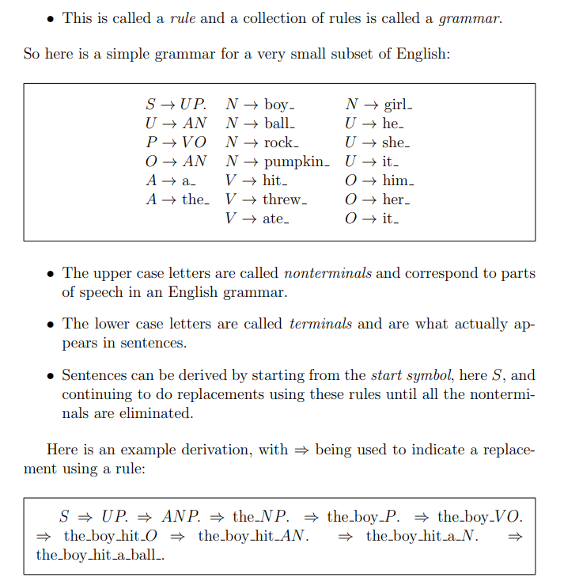
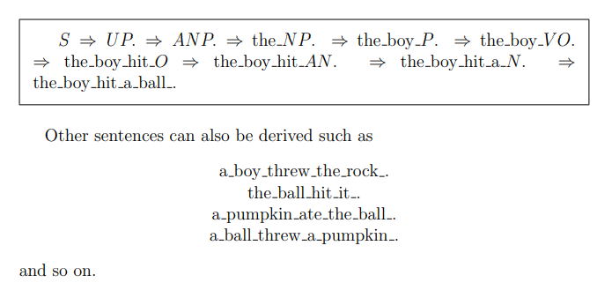
Context-Free Grammars for English

Slide 21
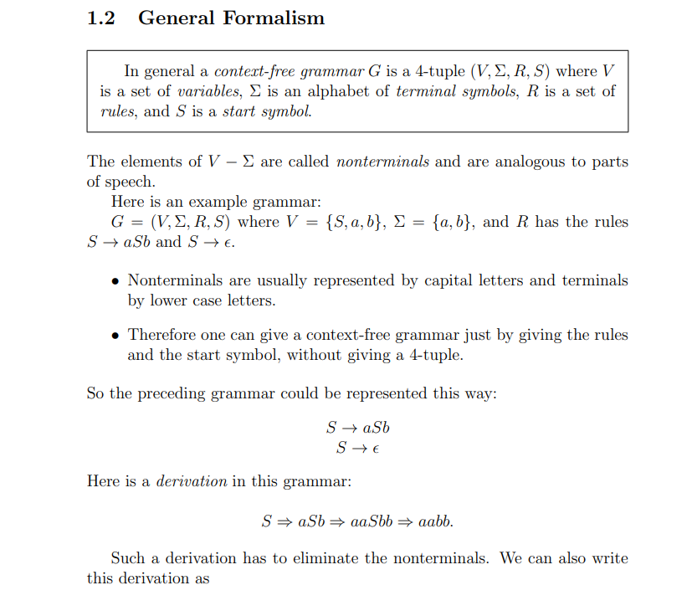
Context-Free Grammars for English

Slide 22
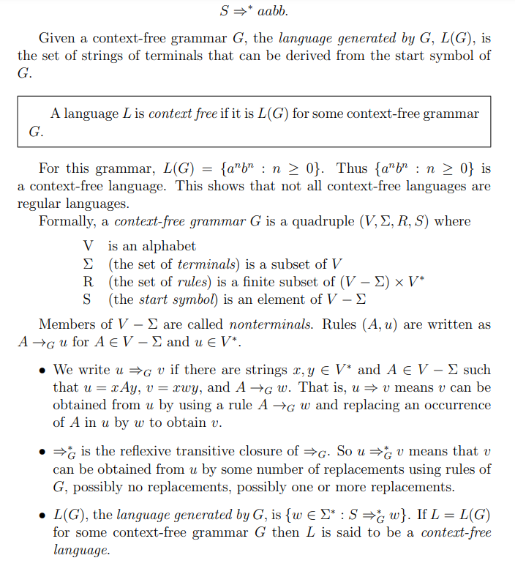
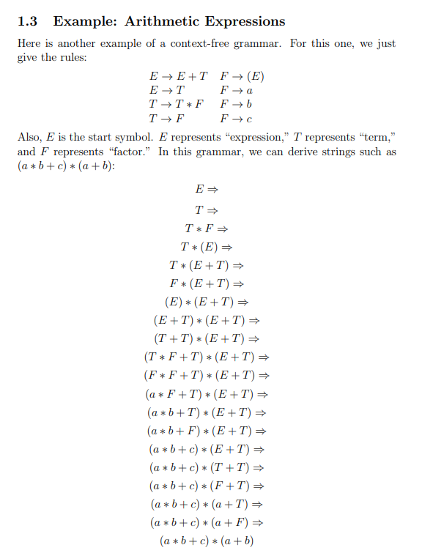
Context-Free Grammars for English

Slide 23
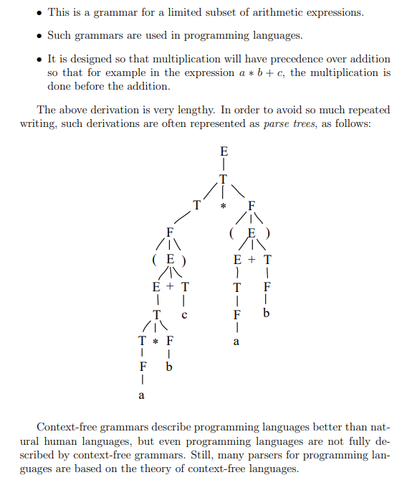
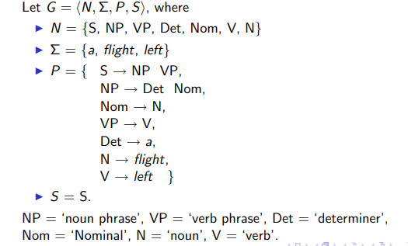
Context-Free Grammars for English

Slide 24
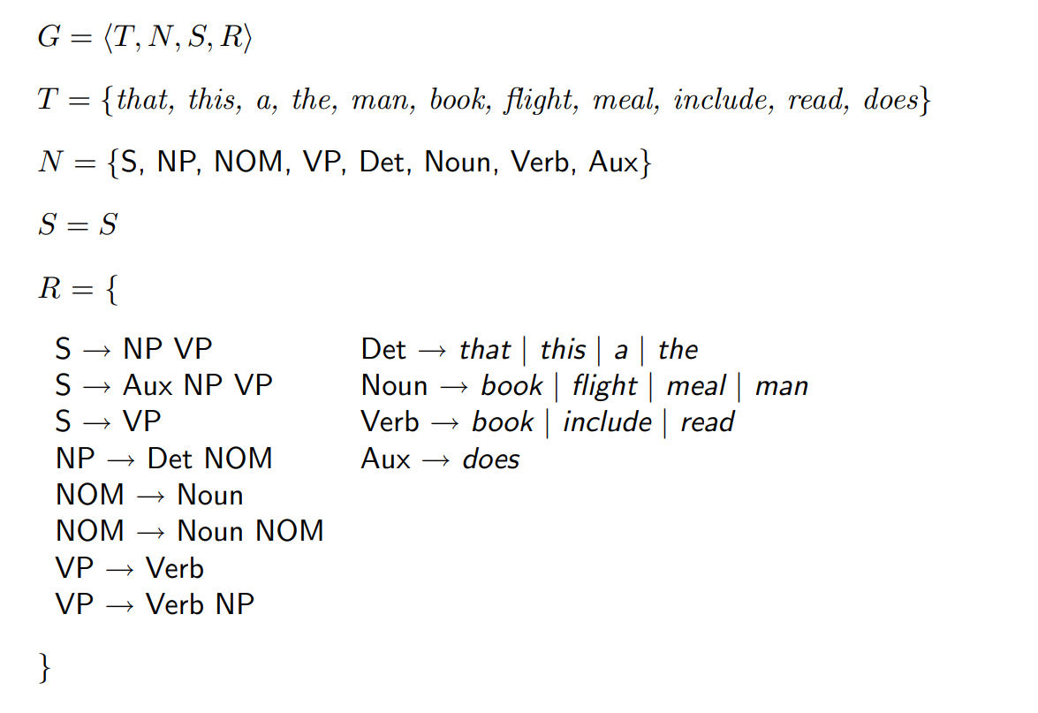
Context-Free Grammars for English

Slide 25
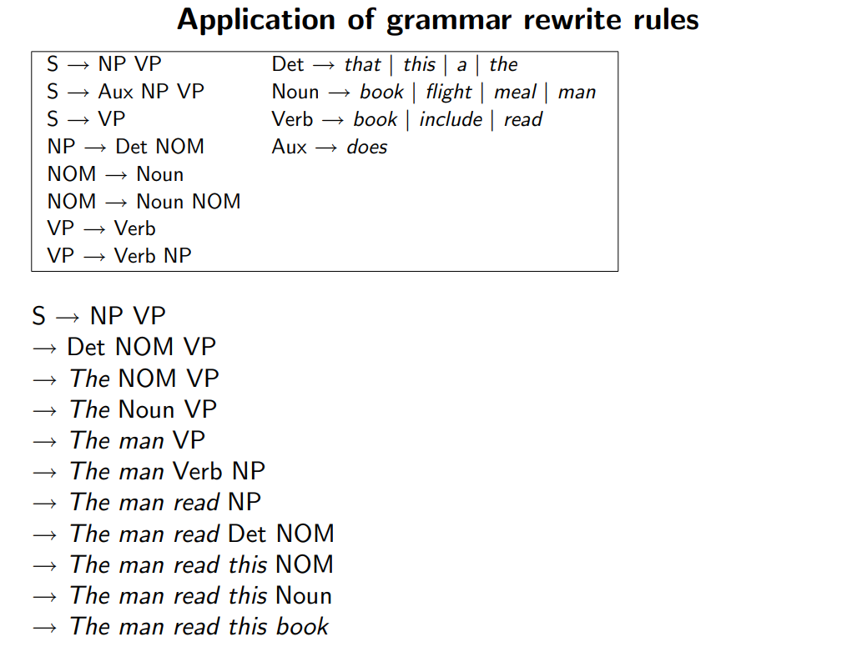
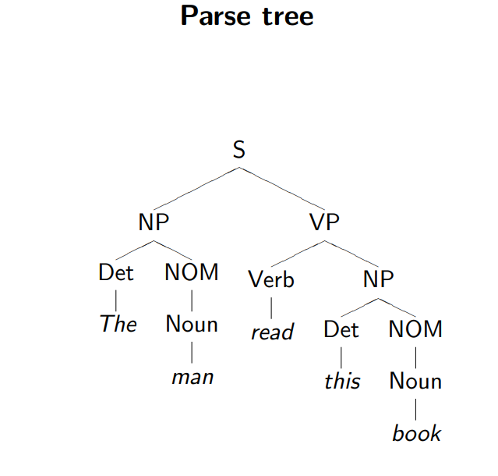
Context-Free Grammars for English & Parse Tree

Slide 26
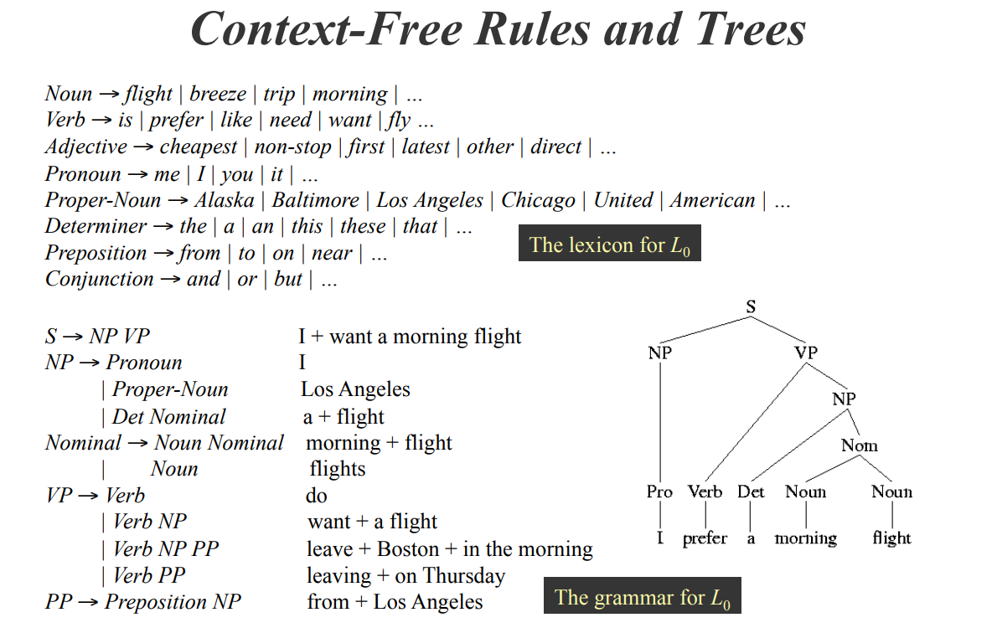
Context-Free Grammars for English & Parse Tree

Slide 27
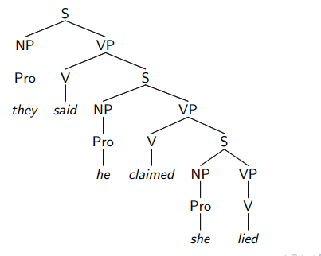
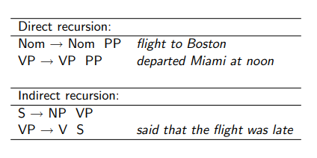
Recursive Grammars for English
Recursive Structures

Slide 28
Types of Syntax Parsing
Dependency Parsing
Constitute Parsing

Slide 29
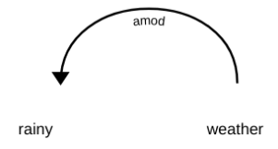
Dependency Parsing
The term Dependency Parsing (DP) refers to the process of examining the dependencies between the phrases of a sentence in order to determine its grammatical structure.
A sentence is divided into many sections based mostly on this.
The process is based on the assumption that there is a direct relationship between each linguistic unit in a sentence. These hyperlinks are called dependencies.
For example, In the phrase ‘rainy weather,’ the word rainy modifies the meaning of the noun weather.
Therefore, a dependency exists from the weather -> rainy in which the weather acts as the head and the rainy acts as dependent or child.
This dependency is represented by amod tag, which stands for the adjectival modifier.

Slide 30
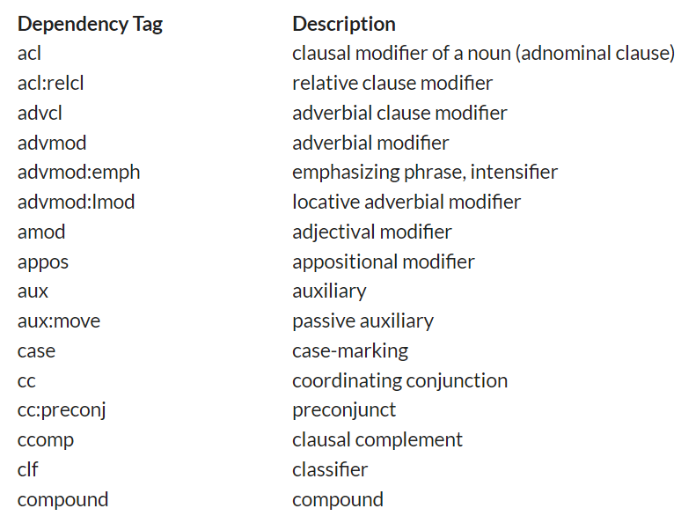
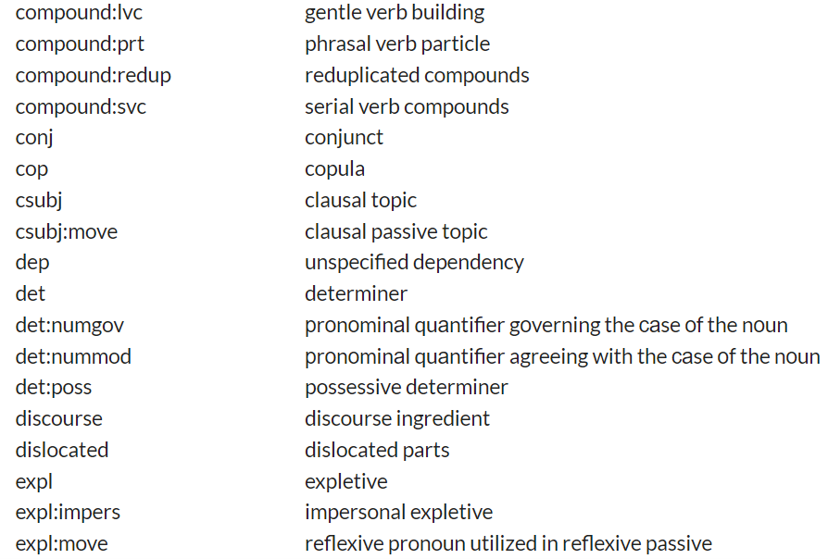
Dependency Parsing
This distinguishes the scenario for dependency between the two phrases, where one serves as the pinnacle and the other as the dependent.
Currently, the Common Dependency V2 taxonomy consists of 37 common syntactic relationships, as shown in the table below:

Slide 31
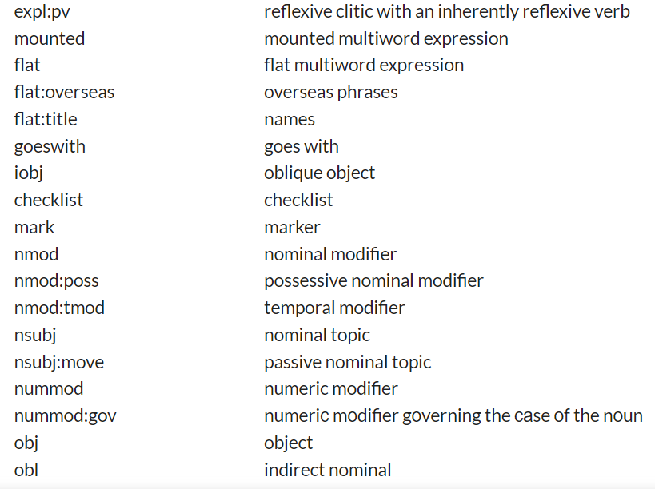
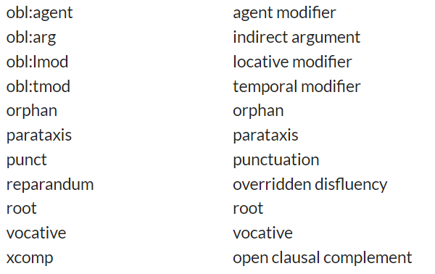
Dependency Parsing

Slide 32
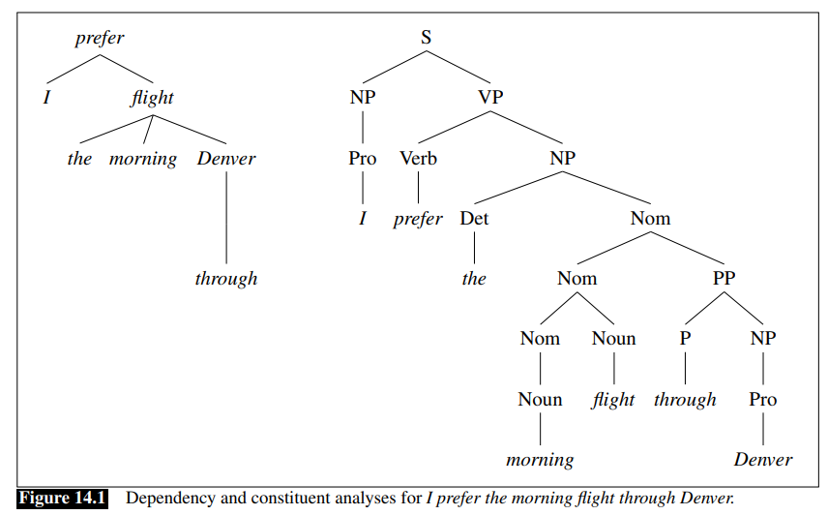
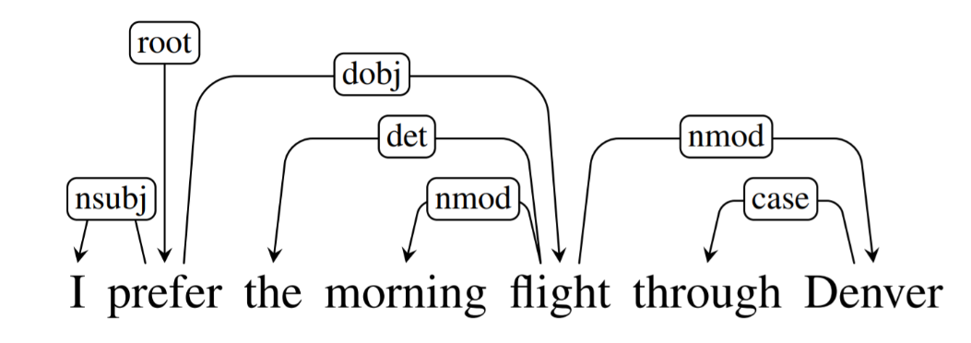
Dependency Parsing

Slide 33
Dependency Parsing using NLTK

